Slide 1
Working with Objects

Slide 2
Churcher Ch5 from p87 on Special Relationships Between Classes Ch 6 Generalisation and Specialisation

Slide 3
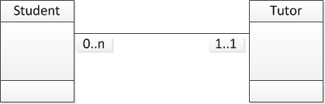
Peer Tutor
We have a peer-tutor service
An initial model might be:
Do you see any issues/problems?
Notes:
Peer-tutor is by definition a student (peer)
Details are stored twice

Slide 4
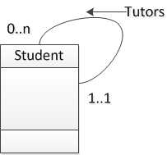
Self Reference
Also sometimes called “Pigs Ear”
Notes:
Other examples: part, parent, father, mother, married

Slide 5
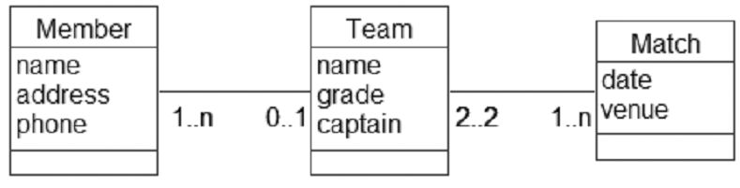
Possible Model of teams, players & Matches
But what do we do if its not uncommon for someone in one team to fill a gap in another?

Slide 6
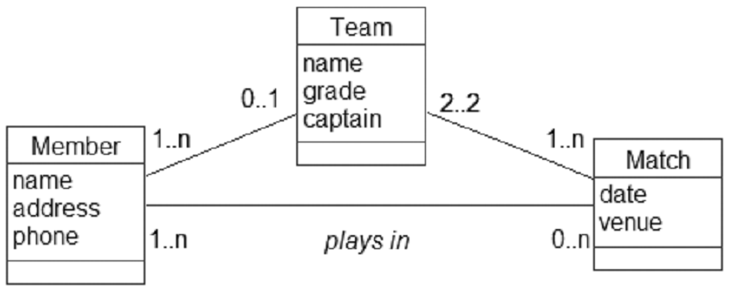
One solution
Any problems?
Notes:
John plays for Team A.
John plays in the match on Tuesday.
The match on Tuesday is between Teams B and C.
If John plays for only one team (as the model indicates), then something weird is going on here.

Slide 7
Ternary relationships
The crucial point is
who played
for which team
in which match
This requires simultaneous knowledge of objects from three classes:
which Member,
which Team, and
which Match.

Slide 8
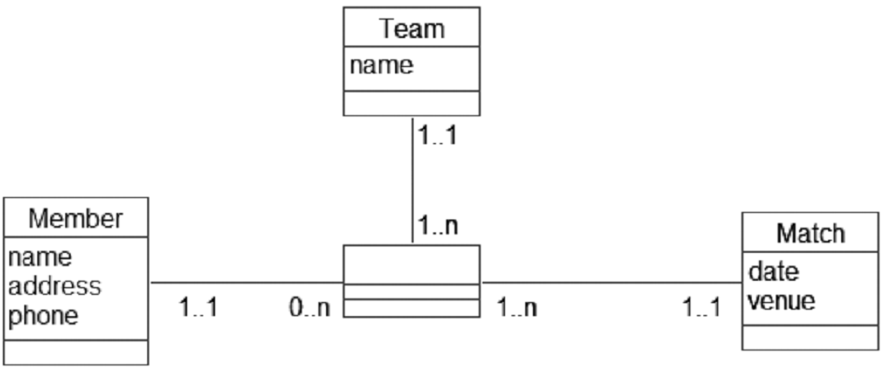
Model of Ternary Relationship

Slide 9
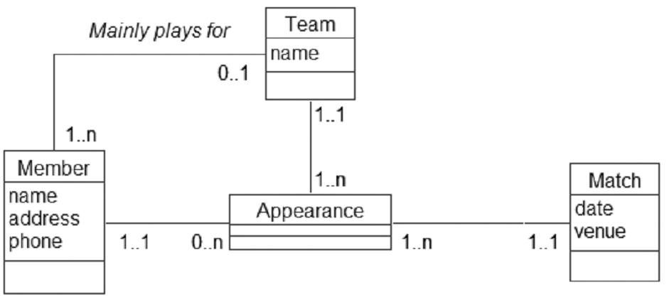
Enhanced to include member’s “main” team

Slide 10
Generalization & Specialization

Slide 11
Classes with many attributes that don’t always apply
A class may be identified with attributes that don’t apply to every occurrence
E.g. staff entity with some staff having hourly rate & others on salary
At other times you may have two classes that are different – but do share a common subset of attributes

Slide 12
Questions to ask
Are there enough instances of staff with a subset of attributes to indicate having separate classes?
Do two classes have enough in common to reconsider defining as one class?

Slide 13
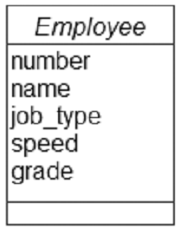
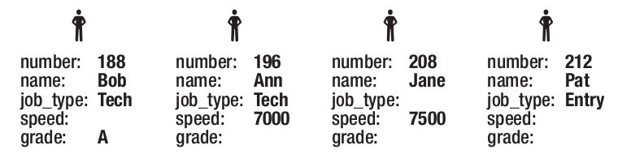
Typical example: Employees
An outsourcing company employing data entry operators and technician’s
Data entry people need to have their typing speed noted
Technician’s have “grades”
Huh?
?
Notes:
Note: Ann is a technician with a speed not a grade
Pat has neither speed or grade

Slide 14
Real question is: Does it matter?
For the purposes of the database
Does it matter that there are inconsistencies such as a technician with a typing speed. Should that be allowed – or even expected?
Can someone be a data entry person AND technician - if so what does the job_type indicate (normal position perhaps?)
Does it matter that a data entry person has no speed? Is that expected in some cases?
What about technician’s – could some be ungraded (or grade unknown?)

Slide 15
Specialization
Previous class is an example of “Specialization”
We have some attributes that apply to all instances (everyone)
Some attributes only apply to a subset
In Data Modelling this is known as sub/super-class:
Superclass (the common attributes)
Subclass (the specialised attributes)
And more generally as “Inheritance”
The same concept as OO programming

Slide 16
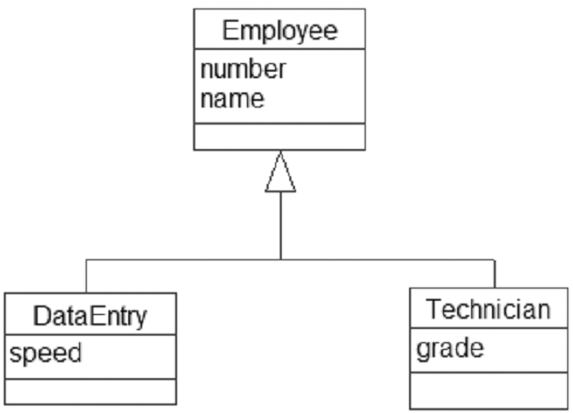
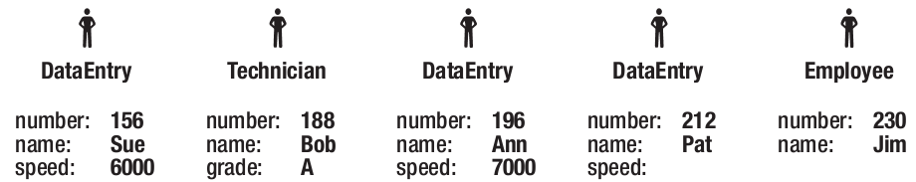
Diagrammatic Representation

Slide 17
Advantages of this model
No possibility to have a data operator with unknown speed or an ungraded technician
Cannot have inconsistencies – a technician with a typing speed but no grade
Does allow for someone to be both data entry and technician
The book doesn’t mention that possibility – but it could happen. Not mutually exclusive.
Further specialities are possible
Electrician with a date to renew licence

Slide 18
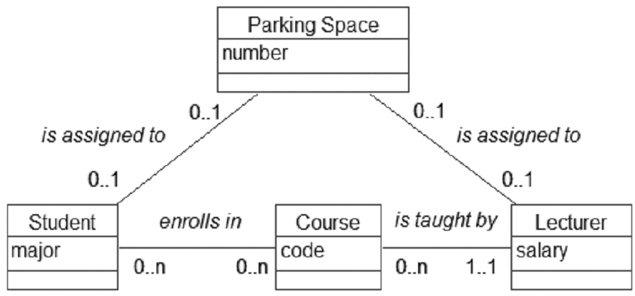
Generalisation – e.g. parking spaces
Can you spot the problem?
Notes:
It is possible that a single parking space might be given to both a student and a staff member

Slide 19
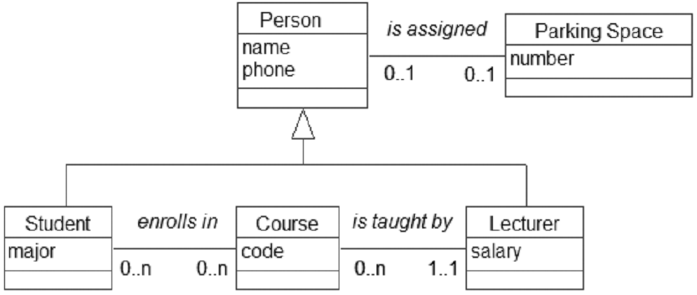
Solution: Generalisation
Use subclass for lecturer & student (fixes other problems too)
Then assign general items to the superclass

Slide 20
When to consider inheritance
When thinking “But a parking space could be associated with a lecturer OR a student” (etc) consider a superclass to capture the common behavior.
“Some objects will have a value for this attribute but not that attribute – they’re almost mutually exclusive” - consider creating some subclasses to capture that specialist behaviour.
If they are truly mutually exclusive then subclasses are even more appropriate (xor can be used to indicate exclusive-or relationships)

Slide 21
Common mistake: Don’t make a subclass when its really an object
Don’t confuse objects with subclass
Only have a class (or subclass) if you really are collecting a group of things. If the class will only ever have one object/instance then it isn’t really a class
Don’t confuse an association with a subclass

Slide 22
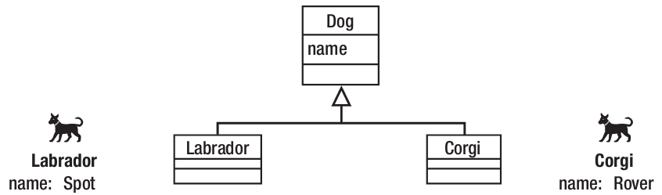
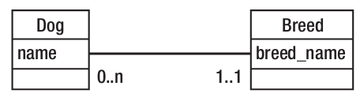
Common mistake: Don’t make a subclass when its really a relationship
Don’t confuse an association with a subclass

Slide 23
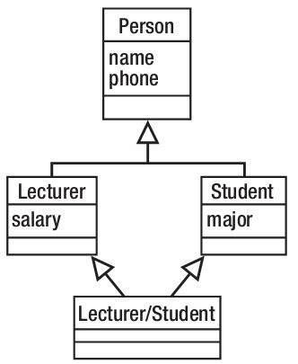
Caution with multiple inheritance
In OO programming multiple inheritance has problems and should be avoided
In data modelling the issues are not the same – multiple inheritance is common
BUT be very careful in further descending
lecturer/student is redundant in this e.g.

Slide 24
In General – Abstract the superclass
Sometimes it might be necessary to allow objects in the superclass only
However, this can result in problems
But in general – try to set things up so that the superclass is an abstract
An abstract class is one that doesn’t have an object made just from it – a subclass needs to be involved

Slide 25
Exercise
Chapter 6 Testing Your Understanding
Model exercise
Car Pool

